Slide 1
Text Structure
A scaffold for scholarly writers.

Slide 2
Why should I care about text structure?
You can’t fit a square peg into a round whole.
You can’t fit the star block through the triangle slot.
You can’t express information without a scaffold to hold it up and keep it organized.

Slide 3
Why should I care about text structure?
Transitional words are the bolts of text structure.
Each text structure has a specific set of transitional words that help connect your ideas in a logical way.

Slide 4
Descriptive:
The author describes the topic by listing characteristics, features, and examples.

Slide 5
Descriptive
Transitional/Clue Words
Questions
Such as
Is like
Next to
Beside
Above
Across
Below
Under
For instance
Including
To illustrate
On top of
Along
For example
In front of
Appears to be
Characteristics
Steps involved
What person, idea, or thing is being described?
Which detail seems to be the most important?
Can you tell how the author feels about what he or she is describing?

Slide 6
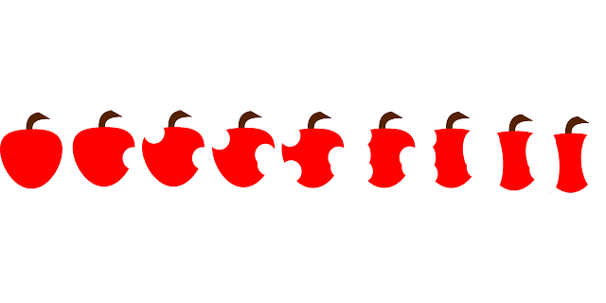
Sequence:
This structure describes a series of events in numerical or chronological order that lead up to a conclusion. Events can be separated by years or just a few seconds.

Slide 7
Sequence
Transitional/Clue Words
Questions
First
Second
Third
Next
While
After
When
Today
Date
Then
Previously
Last
During
Until
Soon
Now
Since
Finally
Time
following
How are the step organized (chronologically or numerically)?
What is the time span of the events?
What do the events describe?
Do the events describe a process?

Slide 8
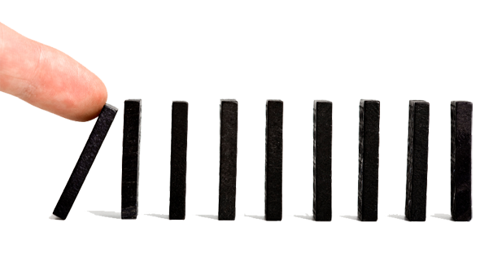
Cause/Effect:
The author describes several reasons why an event occurred or describes several effects from one cause, or the author describes a single cause/effect situation.

Slide 9
Cause/Effect
Transitional/Clue Words
Questions
In order to
Since
Therefore
As a result
Before
Consequently
Accordingly
Reasons why
The effect of
For this reason
On account of
Because
So that
Why
Due to
This led to
What is the cause?
What is the effect?
Is there more than one cause and effect?
What is the result?
What is the reason the result happened?

Slide 10
Compare/Contrast:
The author describes how two or more events, places, things, or ideas are alike and/or different.

Slide 11
Compare/Contrast
Transitional/Clue Words
Questions
Both
Yet
Just like
But
Different
Same as
Unlike
Also
Too
On the contrary
On the other hand
However
Even though
Similarly
Although
Alike
Either/or
Just as
As well
In comparison
What things are being compared (places, objects, events, or ideas)?
How are they alike?
How are they different?
What are the most important similarities or differences?

Slide 12
Problem/Solution:
The author identifies a problem, gives possible solutions with possible results, and describes the solution that was finally chosen.

Slide 13
Problem/Solution
Transitional/Clue Words
Questions
Problem
Because
Hopeful
So that
If/then
Answer
Struggle
Threat
Worry
One reason for
Solution
Solve
Since
Difficulty
Question
Future
Dilemma
Possibility
need
What is the problem?
What caused the problem?
What are some possible solutions?
Who or what will work to solve the problem?

