Slide 1
Heinz Dilemma
an exercise in ethical judgment

Slide 2
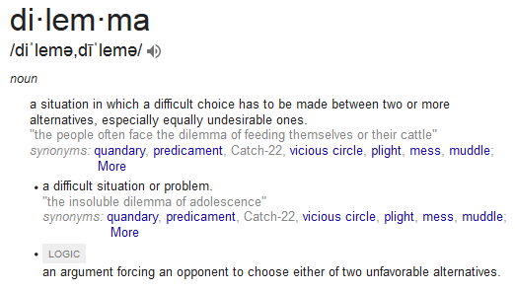

Slide 3
Read the dilemma quietly to yourself. Then, write for 3 minutes on your initial thoughts on the situation.
In Europe, a woman was near death from cancer. One drug might save her, a form of radium that a druggist in the same town had recently discovered. The druggist was charging $2,000, ten times what the drug cost him to make. The sick woman’s husband, Heinz, went to everyone he knew to borrow the money, but he could only get together about half of what it cost. He told the druggist that his wife was dying and asked him to sell it cheaper or let him to sell it cheaper or let him pay later. But the druggist said, “No.” The husband got desperate and broke into the man’s store to steal the drug for his wife. Should the husband have done that? Why? Why not?

Slide 4
Discuss the dilemma and your thoughts with your partner or group. Use the questions at the bottom as a guide for your discussion.
Should Heinz steal the drug? Why or why not?
If Heinz doesn't love his wife, should he steal the drug for her? Why or why not?
Suppose the person dying is not his wife but a stranger. Should Heinz steal the drug for a stranger? Why or why not?
Suppose it is a pet animal he loves. Should Heinz steal to save the pet animal? Why or why not?
Should people do everything they can to save another's life? Why/Why not?
It is against the law for Heinz to steal. Does that make it morally wrong? Why or why not?
Why should people generally do everything they can to avoid breaking the? How does this relate to Heinz's case?

Slide 5
Reflection Journal
Choose 1-3 of the discussion questions to elaborate on in your journal. In your response, you should cite at least one comment made by a peer in class today. Cite them by name, explain a point they made, and offer your response to it.

Slide 6
Reflection Journal (CORE EX)
Is crime ever justified? Use the Heinz Dilemma as an example to support your answer.
In your response, you should cite at least one comment made by a peer in class today. Cite them by name, explain a point they made, and offer your response to it.

